Slide 1
Informed Search and Exploration
Shanghai Jiao Tong University

Slide 2
Outline
Best-first search
Greedy best-first search
A* search
Heuristics
Local search algorithms
Hill-climbing search
Simulated annealing search
Local beam search
Genetic algorithms

Slide 3
Best-first search
Idea: use an evaluation function f(n) for each node
  estimate of "desirability“
  Expand most desirable unexpanded node
Implementation:
Order the nodes in fringe in decreasing order of desirability
Special cases:
  greedy best-first search
  A* search

Slide 4

Romania with step costs in km

Slide 5
Greedy best-first search
Evaluation function
f(n) = h(n) (heuristic)
= estimate of cost from n to goal
Greedy best-first search expands the node that appears to be closest to goal
e.g., hSLD(n) = straight-line distance from n to Bucharest

Slide 6
Properties of greedy best-first search
Complete? No – can get stuck in loops, e.g., Iasi → Neamt → Iasi → Neamt →
Time? O(b^{m}), but a good heuristic can give dramatic improvement
Space? O(b^{m}) -- keeps all nodes in memory
Optimal? No

Slide 7
A* search
Idea: avoid expanding paths that are expensive
Evaluation function f(n) = g(n) + h(n)
g(n) = cost so far to reach n
h(n) = estimated cost from n to goal
f(n) = estimated total cost of path through n to goal

Slide 8





A* search example

Slide 9
Admissible heuristics
A heuristic h(n) is admissible if for every node n,
h(n) ≤ h*(n), where h*(n) is the true cost to reach the goal state from n.
An admissible heuristic never overestimates the cost to reach the goal, i.e., it is optimistic
Example: h_{SLD}(n) (never overestimates the actual road distance)
Theorem: If h(n) is admissible, A* using TREE-SEARCH is optimal

Slide 10

Optimality of A* (proof)
Suppose some suboptimal goal G₂ has been generated and is in the fringe. Let n be an unexpanded node in the fringe such that n is on a shortest path to an optimal goal G.
f(G₂) = g(G₂) since h(G₂) = 0
g(G₂) > g(G) since G₂ is suboptimal
f(G) = g(G) since h(G) = 0
f(G₂) > f(G) from above

Slide 11
Optimality of A* (proof)
Suppose some suboptimal goal G₂ has been generated and is in the fringe. Let n be an unexpanded node in the fringe such that n is on a shortest path to an optimal goal G.
f(G₂) > f(G) from above
h(n) ≤ h^*(n) since h is admissible
g(n) + h(n) ≤ g(n) + h*(n)
f(n) ≤ f(G)
Hence f(G₂) > f(n), and A* will never select G₂ for expansion

Slide 12

Consistent Heuristics
A heuristic is consistent if for every node n, every successor n' of n generated by any action a, then
h(n) ≤ c(n,a,n') + h(n')
If h is consistent, we have
f(n') = g(n') + h(n')
= g(n) + c(n,a,n') + h(n')
≥ g(n) + h(n)
= f(n)
Theorem: If h(n) is consistent, A* using GRAPH-SEARCH is optimal
i.e., f(n) is non-decreasing along any path.

Slide 13

Optimality of A*
A* expands nodes in order of increasing f value
Gradually adds "f-contours" of nodes
Contour i has all nodes with f=f_{i}, where f_{i} < f_{i+1}

Slide 14
Properties of A*
Complete? Yes (unless there are infinitely many nodes with f ≤ f(G) )
Time? Exponential
Space? Keeps all nodes in memory
Optimal? Yes

Slide 15

Heuristic Function
Admissible heuristics
E.g., for the 8-puzzle:
h₁(n) = number of misplaced tiles
h₂(n) = total Manhattan distance
(i.e., no. of squares from desired location of each tile)
h₁(S) = ?
h₂(S) = ?

Slide 16
Admissible heuristics
E.g., for the 8-puzzle:
h₁(n) = number of misplaced tiles
h₂(n) = total Manhattan distance
(i.e., no. of squares from desired location of each tile)
h₁(S) = ? 8
h₂(S) = ? 3+1+2+2+2+3+3+2 = 18

Slide 17
Dominance
If h₂(n) ≥ h₁(n) for all n (both admissible)
then h₂ dominates h₁
===》 h₂ is better for search
Typical search costs (average number of nodes expanded):
d=12 IDS = 3,644,035 nodes (ITERATIVE-DEEPENING-SEARCH)
A*(h₁) = 227 nodes
A*(h₂) = 73 nodes
d=24 IDS = too many nodes
A*(h₁) = 39,135 nodes
A*(h₂) = 1,641 nodes

Slide 18
Relaxed Problems
A problem with fewer restrictions on the actions is called a relaxed problem
The cost of an optimal solution to a relaxed problem is an admissible heuristic for the original problem
If the rules of the 8-puzzle are relaxed so that a tile can move anywhere, then h₁(n) gives the shortest solution
If the rules are relaxed so that a tile can move to any adjacent square, then h₂(n) gives the shortest solution

Slide 19
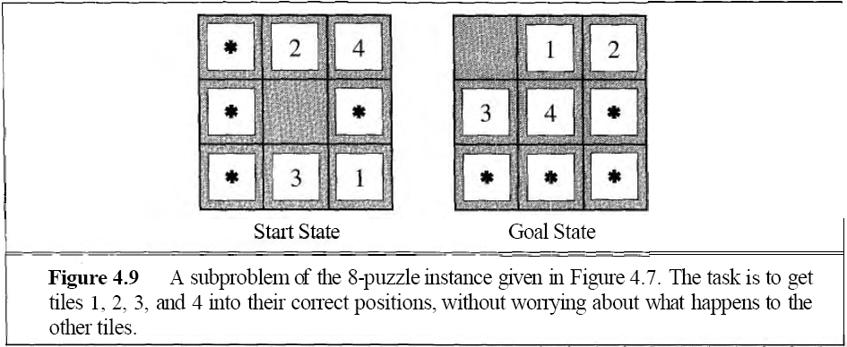
Solution cost of a subproblem

Slide 20
Local search algorithms
In many optimization problems, the path to the goal is irrelevant; the goal state itself is the solution
State space = set of "complete" configurations
Find configuration satisfying constraints, e.g., n-queens
In such cases, we can use local search algorithms
keep a single "current" state, try to improve it

Slide 21

Example: n-queens
Put n queens on an n × n board with no two queens on the same row, column, or diagonal

Slide 22

Hill-climbing search
"Like climbing Everest in thick fog with amnesia"

Slide 23

Hill-climbing search
Problem: depending on initial state, can get stuck in local maxima

Slide 24

Hill-climbing search: 8-queens problem
h = number of pairs of queens that are attacking each other, either directly or indirectly
h = 17 for the above state

Slide 25

Hill-climbing search: 8-queens problem
A local minimum with h = 1

Slide 26

Simulated annealing search
Idea: escape local maxima by allowing some "bad" moves but gradually decrease their frequency

Slide 27
Properties of simulated annealing search
One can prove: If T decreases slowly enough, then simulated annealing search will find a global optimum with probability approaching 1
Widely used in VLSI layout, airline scheduling, etc

Slide 28
Local beam search
Keep track of k states rather than just one
Start with k randomly generated states
At each iteration, all the successors of all k states are generated
If any one is a goal state, stop; else select the k best successors from the complete list and repeat.

Slide 29
Genetic algorithms
Genetic Algorithm

Slide 30

Genetic algorithms

Slide 31
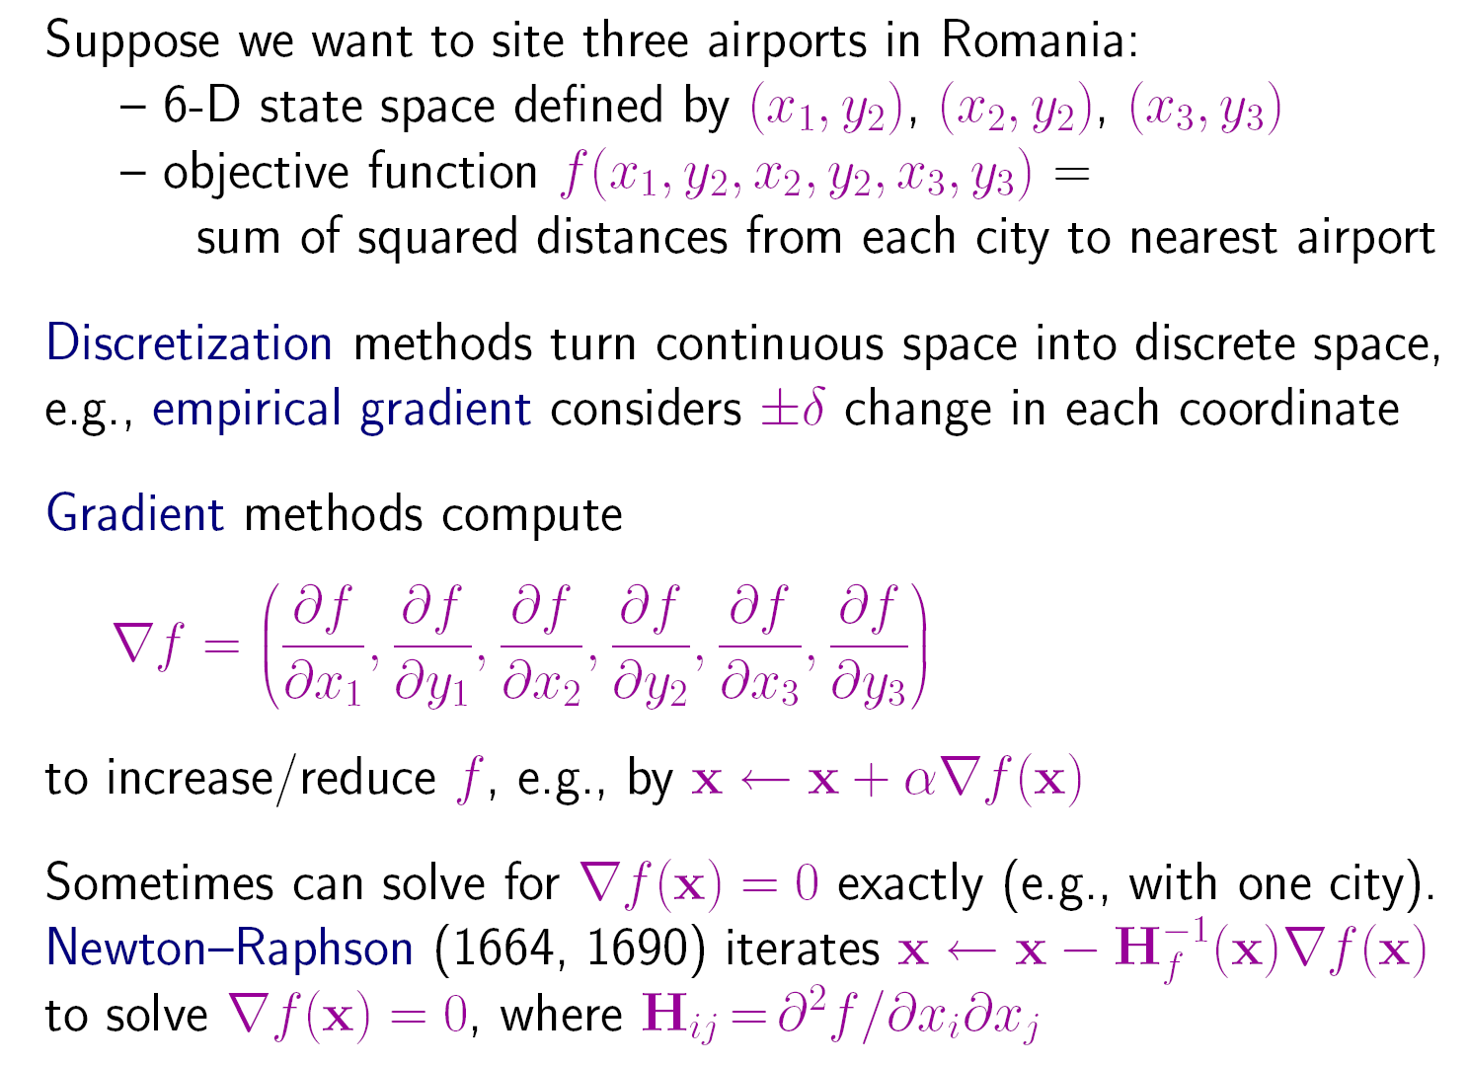

Local Search in Continuous Spaces

Slide 32
First Project: 8-queens Problem
To formulate 8-queens problem into the search problem in a state space
To define a heuristic function
To implement A* Algorithm to find solutions
To write a report on the simulation result.

Slide 33
Questions?
What further problems will we meet?
  Constraints
  Multi-agents
  Uncertainty

Slide 34
The Go Text Protocol(GTP)
http://www.lysator.liu.se/~gunnar/gtp/
http://sourceforge.net/projects/gogui/

Slide 35
End of the Talk

